Slide 1


Introduction
Objective:
Healthcare Analytics with SQL By Abubakkar Siddiq
Utilize SQL to analyze healthcare data and generate insights.
Apply various SQL techniques including Joins, Aggregations, Window Functions, and Subqueries.
Database Schema:
Patients: Stores patient details.
Doctors: Stores doctor details.
Appointments: Tracks patient visits.
Diagnoses: Stores patient diagnoses.
Medications: Tracks prescribed medicines.

Slide 2
Introduction
Objective:
Utilize SQL to analyze healthcare data and generate insights.
Apply various SQL techniques including Joins, Aggregations, Window Functions, and Subqueries.
Database Schema:
Patients: Stores patient details.
Doctors: Stores doctor details.
Appointments: Tracks patient visits.
Diagnoses: Stores patient diagnoses.
Medications: Tracks prescribed medicines.

Slide 3
SQL Queries and Insights
Inner and Equi Joins Query: Retrieve details of completed appointments with patient and doctor details.
SELECT p.name AS patient_name, d.name AS doctor_name, d.specialization, a.appointment_date
FROM Appointments a
INNER JOIN Patients p ON a.patient_id = p.patient_id
INNER JOIN Doctors d ON a.doctor_id = d.doctor_id
WHERE a.status = 'Completed';
Learning: Understanding Inner Joins and filtering data.

Slide 4
Left Join with Null Handling
Left Join with Null Handling Query: Retrieve patients who have never had an appointment.
SELECT p.name AS patient_name, p.contact_number, p.address
FROM Patients p
LEFT JOIN Appointments a ON p.patient_id = a.patient_id
WHERE a.patient_id IS NULL;
Learning: Using Left Joins and handling NULL values.
Left Join Concept
A LEFT JOIN returns all records from the left table (Patients) and matching records from the right table (Appointments). When no match exists, NULL values appear in the result for columns from the right table.

Slide 5
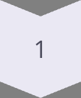
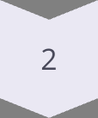
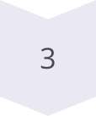
Right Join and Aggregate Functions
Right Join and Aggregate Functions Query: Find total diagnoses for each doctor.
SELECT d.name AS doctor_name, d.specialization, COUNT(di.diagnosis_id) AS total_diagnoses
FROM Doctors d
RIGHT JOIN Diagnoses di ON d.doctor_id = di.doctor_id
GROUP BY d.doctor_id, d.name, d.specialization;
Learning: Applying Right Joins with Aggregations.
Right Join
Returns all records from the right table and matching from the left
GROUP BY
Organizes data by specified columns
COUNT()
Aggregates the number of diagnoses

Slide 6
Full Join for Overlapping Data
Full Join for Overlapping Data Query: Identify mismatches between Appointments and Diagnoses.
SELECT COALESCE(a.appointment_id, d.diagnosis_id) AS record_id, p.name AS patient_name, doc.name AS doctor_name, doc.specialization, a.appointment_date, d.diagnosis, d.treatment
FROM Appointments a
FULL OUTER JOIN Diagnoses d ON a.patient_id = d.patient_id AND a.doctor_id = d.doctor_id
LEFT JOIN Patients p ON COALESCE(a.patient_id, d.patient_id) = p.patient_id
LEFT JOIN Doctors doc ON COALESCE(a.doctor_id, d.doctor_id) = doc.doctor_id
WHERE a.appointment_id IS NULL OR d.diagnosis_id IS NULL;
Learning: Using Full Joins for data validation.

Slide 7
Window Functions (Ranking and Aggregation)
Window Functions (Ranking and Aggregation) Query: Rank doctors based on the number of appointments.
SELECT d.Doctor_ID, d.name, COUNT(a.Appointment_ID) AS Appointment_Count,
RANK() OVER (ORDER BY COUNT(a.Appointment_ID) DESC) AS Patient_Rank
FROM Appointments a
JOIN Doctors d ON a.Doctor_ID = d.Doctor_ID
GROUP BY d.Doctor_ID, d.name;
Learning: Applying RANK() for ranking data.
Window Functions
RANK()
Benefits
Perform calculations across a set of rows related to the current row, enabling complex analytics without grouping results.
Assigns a rank to each row within a partition of a result set, with the same rank for ties and gaps in the sequence.
Allows sophisticated analytics while preserving row details, unlike GROUP BY which collapses rows.

Slide 8

Complex Joins and Aggregation Query
Identify the doctor with the most unique patients.
SELECT d.name AS doctor_name, d.specialization, COUNT(DISTINCT a.patient_id) AS unique_patient_count
FROM doctors d
JOIN appointments a ON d.doctor_id = a.doctor_id
GROUP BY d.doctor_id, d.name, d.specialization
ORDER BY unique_patient_count DESC
LIMIT 1;
This query showcases how to use complex joins (JOIN) and aggregation functions (COUNT, DISTINCT) to identify a doctor with the most unique patients. It uses a GROUP BY clause to group the results by doctor, and the ORDER BY and LIMIT clauses to retrieve the doctor with the highest unique patient count.

Slide 9
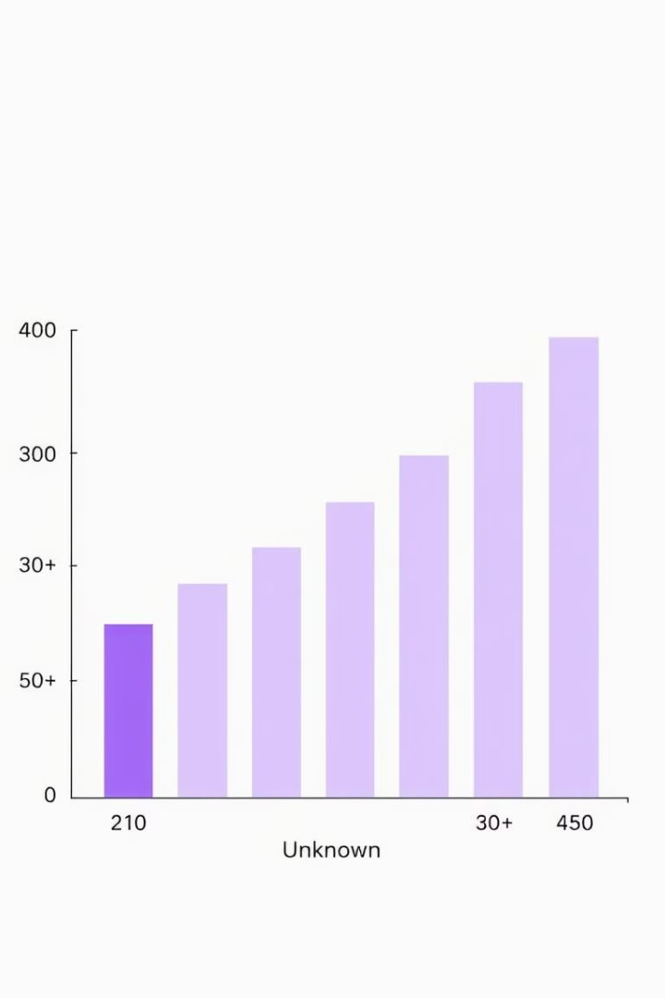
Conditional Expressions Query
Categorize patients by age group.
SELECT CASE
WHEN age BETWEEN 18 AND 30 THEN '18-30'
WHEN age BETWEEN 31 AND 50 THEN '31-50'
WHEN age >= 51 THEN '51+'
ELSE 'Unknown'
END AS age_group, COUNT(*) AS patient_count
FROM patients
GROUP BY age_group
ORDER BY age_group;
This query showcases how to use CASE statements to categorize data based on conditions. It uses COUNT function to count patients in each age group, and the GROUP BY and ORDER BY clauses to organize the results.

Slide 10
Numeric and String Functions
Numeric and String Functions Query: Retrieve patients whose contact numbers end with "1234" in uppercase.
SELECT UPPER(name) AS patient_name, contact_number
FROM patients
WHERE contact_number LIKE '%1234';
Learning: String manipulation using UPPER() and LIKE.
String Functions
Pattern Matching
UPPER() - Converts text to uppercase
LIKE - Simple pattern matching
LOWER() - Converts text to lowercase
'%' - Matches any sequence of characters
LENGTH() - Returns string length
'_' - Matches any single character
SUBSTRING() - Extracts part of string
ILIKE - Case-insensitive matching (some databases)

Slide 11
Subqueries for Filtering
Subqueries for Filtering Query: Find patients who have only been prescribed "Insulin".
SELECT DISTINCT a.Patient_ID
FROM appointments a
JOIN diagnoses d ON a.patient_ID = d.patient_ID
JOIN medications m ON d.Diagnosis_ID = m.Diagnosis_ID
WHERE a.Patient_ID NOT IN (
SELECT DISTINCT a2.Patient_ID
FROM appointments a2
JOIN diagnoses d2 ON a2.patient_ID = d2.patient_ID
JOIN medications m2 ON d2.Diagnosis_ID = m2.Diagnosis_ID
WHERE m2.Medication_Name <> 'Insulin'
);
Learning: Using subqueries for advanced filtering.
Final Result
NOT IN Filtering
Returns only patients exclusively prescribed Insulin
Inner Query Execution
Excludes those patients from the main query results
Finds all patients who have been prescribed medications other than Insulin

Slide 12

Date and Time Functions Query
Calculate the average medication duration for each diagnosis.
SELECT d.Diagnosis_ID, d.Diagnosis, AVG(ABS(m.End_Date - m.Start_Date)) AS Avg_Duration_Days
FROM diagnoses d
JOIN medications m ON d.Diagnosis_ID = m.Diagnosis_ID
GROUP BY d.Diagnosis_ID, d.Diagnosis;
This query demonstrates the use of date functions (ABS, AVG) to calculate the difference between two dates. It uses a JOIN to combine data from the diagnoses and medications tables, and the GROUP BY clause to aggregate the results by diagnosis.

Slide 13


Conclusion
SQL provides powerful tools for healthcare analytics. Effective use of Joins, Aggregations, and Window Functions enhances data analysis. Implementing these techniques ensures better insights and decision-making in healthcare data management.

